Slide 1


Slide 2
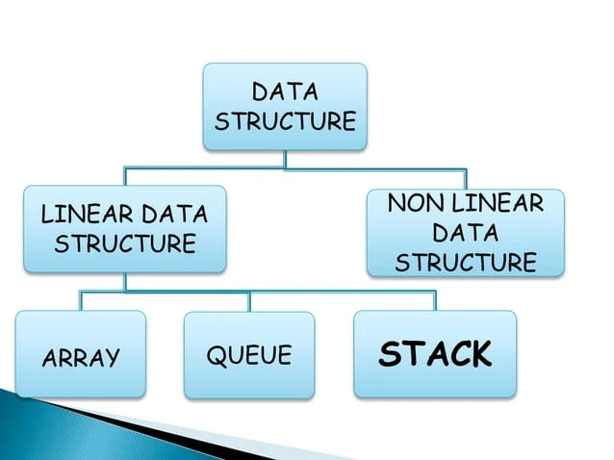

Slide 3
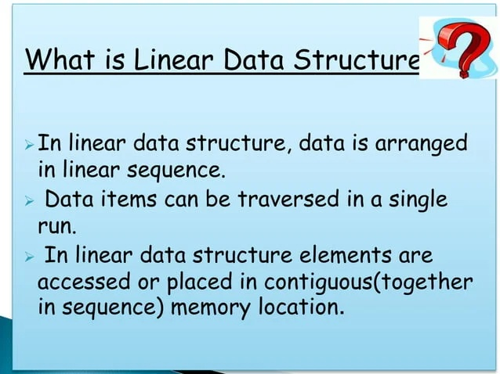

Slide 4
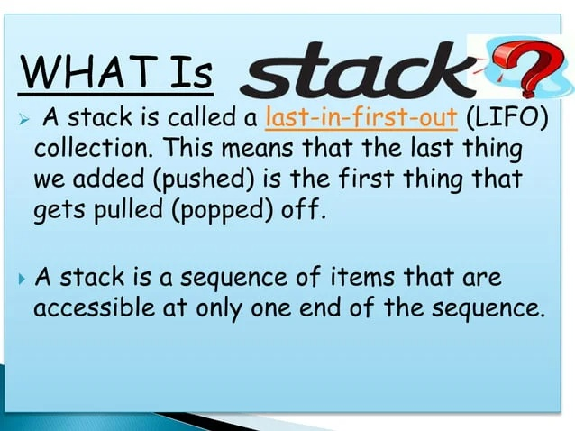

Slide 5
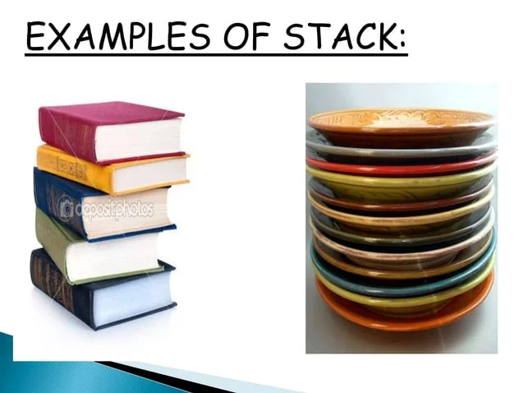

Slide 6
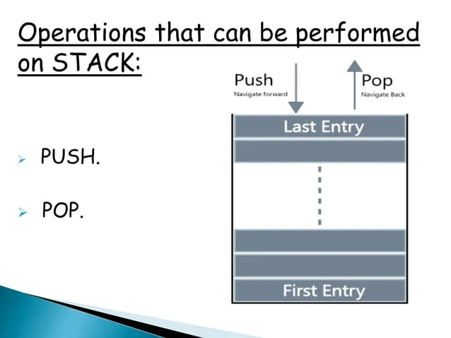

Slide 7
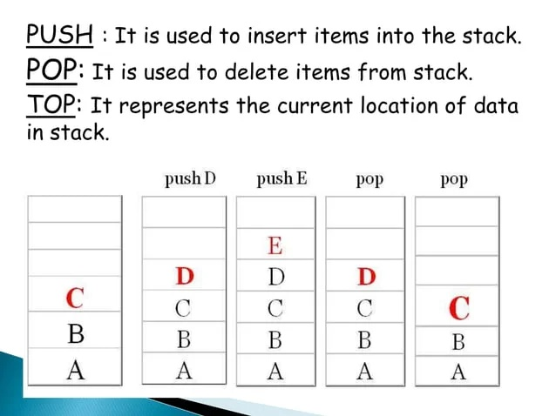

Slide 8
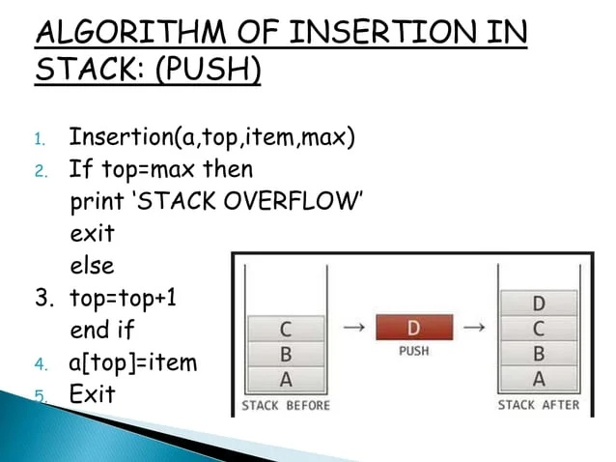

Slide 9
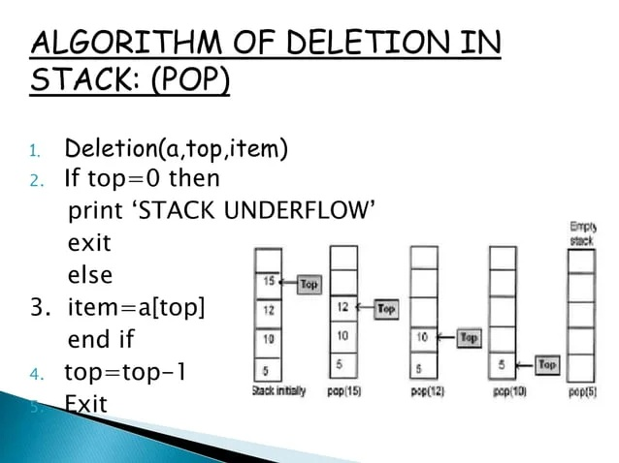

Slide 10
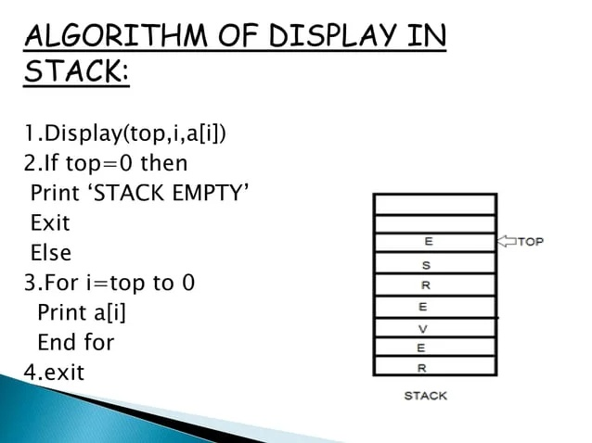

Slide 11
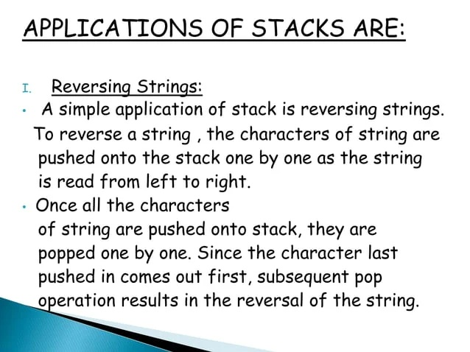

Slide 12
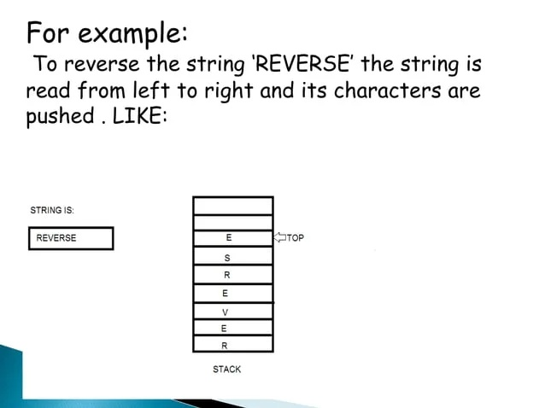

Slide 13
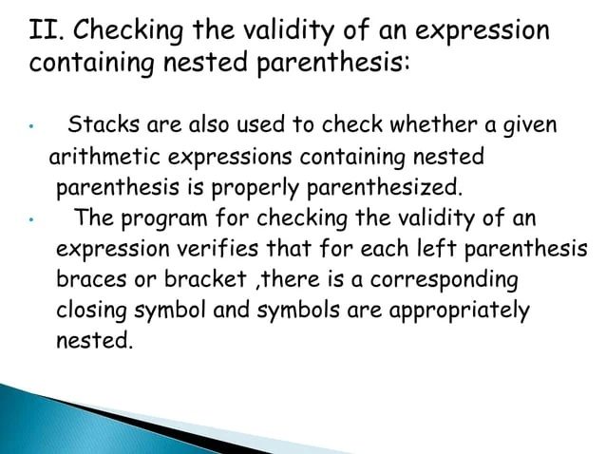

Slide 14
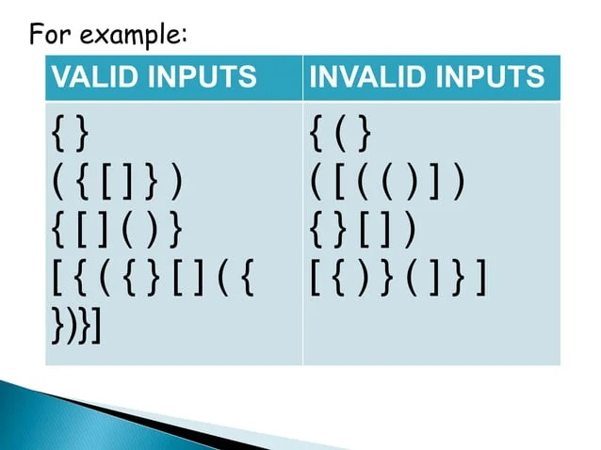

Slide 15
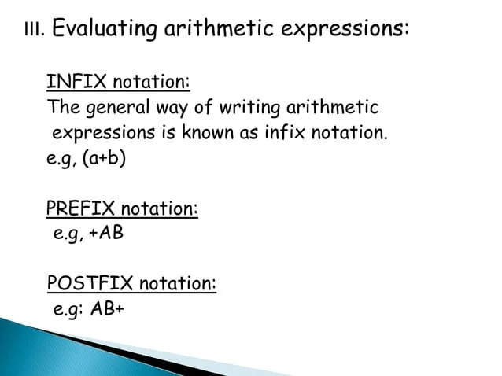

Slide 16
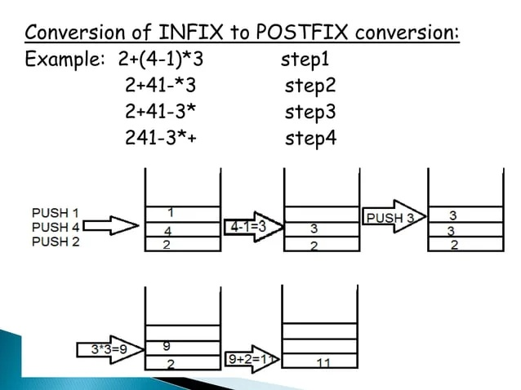

Slide 17
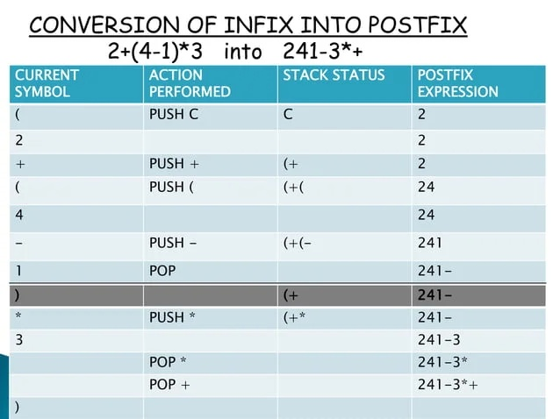

Slide 18
An expression consists of constants, variables, and symbols. Symbols can be operators or parenthesis.
All these components must be arranged according to a set of rules so that all these expressions can be evaluated using the set of rules.
Examples of expressions are:
5 + 6
A - B
(P * 5)
All the above expressions have a common structure, i.e., we have an operator between the two operands. An Operand is an object or a value on which the operation is to be performed. In the above expressions, 5, 6 are the operands while '+', '-', and '*' are the operators.

Slide 19
What is infix notation?
When the operator is written in between the operands, then it is known as infix notation. Operand does not have to be always a constant or a variable; it can also be an expression itself.
If there are multiple operators involved in an expression, we have to remember their precedence.
Operators | Symbols
Parenthesis | ( ), {}, [ ] (L-R)
Exponents | ^ (R-L)
Multiplication and Division | *, / (L-R)
Addition and Subtraction | + , - (L-R)

Slide 20
The operators that have the same precedence termed as operator associativity. If we go from left to right, then it is known as left-associative. If we go from right to left, then it is known as right-associative.
Problem with infix notation
We have to remember operators precedence and associativity rules.
Mathematicians and logicians studied this problem and discovered two other ways of writing expressions which are prefix and postfix. Both expressions do not require any parenthesis and can be parsed without ambiguity. It does not require operator precedence and associativity rules.

Slide 21
Postfix Expression
The postfix expression is an expression in which the operator is written after the operands.
Some key points regarding the postfix expression are:
In postfix expression, operations are performed in the order in which they have written from left to right.
It does not any require any parenthesis.
We do not need to apply operator precedence rules and associativity rules.

Slide 22
Evaluation of postfix expression using stack
Scan the expression from left to right.
If we encounter any operand in the expression, then we push the operand in the stack.
When we encounter any operator in the expression, then we pop the corresponding operands from the stack.
When we finish with the scanning of the expression, the final value remains in the stack.

Slide 23
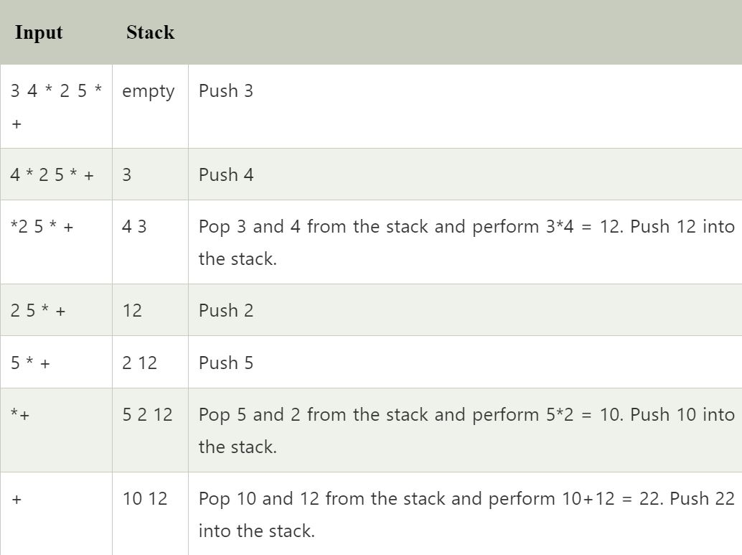

Slide 24
Conversion of infix to postfix
Rules for the conversion from infix to postfix expression
Print the operand as they arrive.
If the stack is empty or contains a left parenthesis on top, push the incoming operator on to the stack.
If the incoming symbol is '(', push it on to the stack.
If the incoming symbol is ')', pop the stack and print the operators until the left parenthesis is found.
If the incoming symbol has higher precedence than the top of the stack, push it on the stack.
If the incoming symbol has lower precedence than the top of the stack, pop and print the top of the stack. Then test the incoming operator against the new top of the stack.
If the incoming operator has the same precedence with the top of the stack then use the associativity rules. If the associativity is from left to right then pop and print the top of the stack then push the incoming operator. If the associativity is from right to left then push the incoming operator.
At the end of the expression, pop and print all the operators of the stack.

Slide 25
Example: K + L - M*N + (O^P) * W/U/V * T + Q
Link=https://www.javatpoint.com/convert-infix-to-postfix-notation
Infix to prefix notation
Rules for the conversion of infix to prefix expression:
First, reverse the infix expression given in the problem.
Scan the expression from left to right.
Whenever the operands arrive, print them.
If the operator arrives and the stack is found to be empty, then simply push the operator into the stack.
If the incoming operator has higher precedence than the TOP of the stack, push the incoming operator into the stack.
If the incoming operator has the same precedence with a TOP of the stack, push the incoming operator into the stack.

Slide 26
If the incoming operator has lower precedence than the TOP of the stack, pop, and print the top of the stack. Test the incoming operator against the top of the stack again and pop the operator from the stack till it finds the operator of a lower precedence or same precedence.
If the incoming operator has the same precedence with the top of the stack and the incoming operator is ^, then pop the top of the stack till the condition is true. If the condition is not true, push the ^ operator.
When we reach the end of the expression, pop, and print all the operators from the top of the stack.
If the operator is ')', then push it into the stack.
If the operator is '(', then pop all the operators from the stack till it finds ) opening bracket in the stack.
If the top of the stack is ')', push the operator on the stack.
Example
K + L - M * N + (O^P) * W/U/V * T + Q
Link=https://www.javatpoint.com/convert-infix-to-prefix-notation

Slide 27
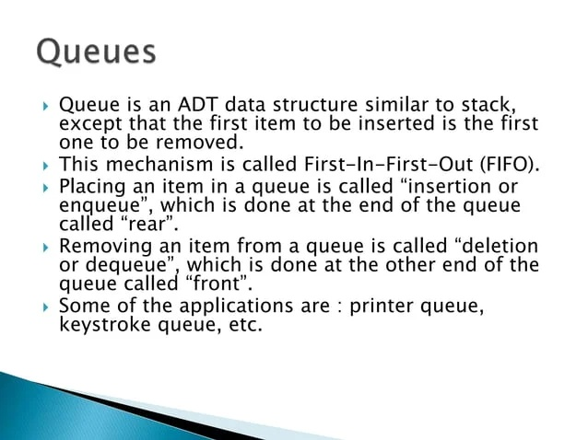

Slide 28
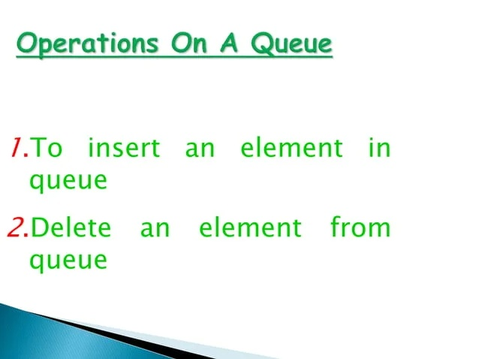

Slide 29
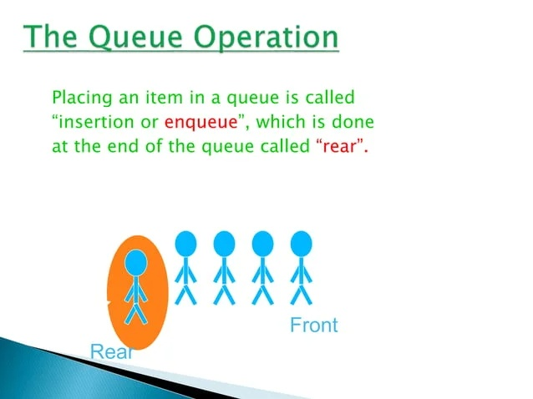

Slide 30
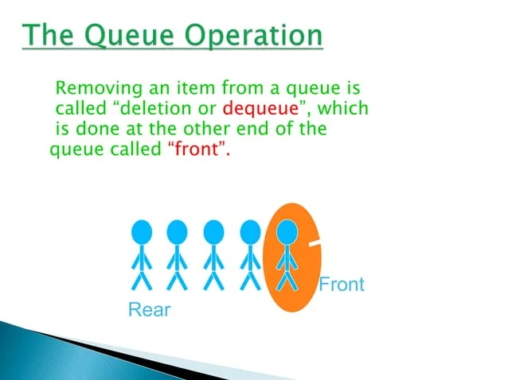

Slide 31
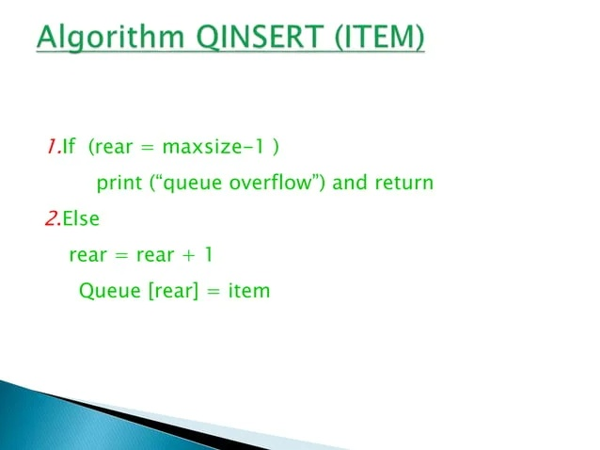

Slide 32
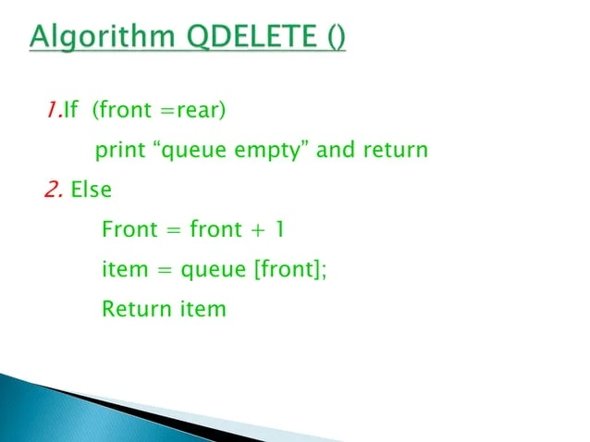

Slide 33
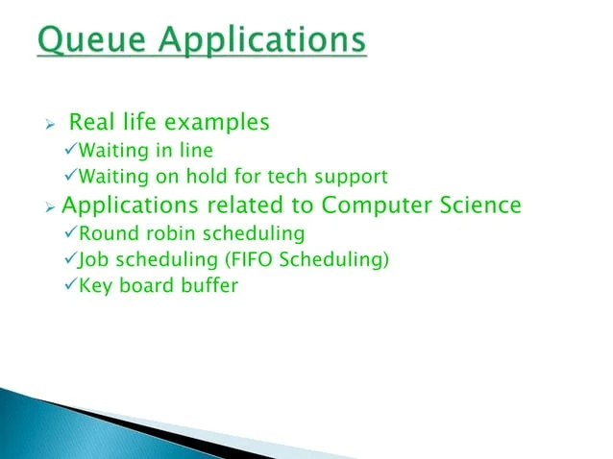

Slide 34
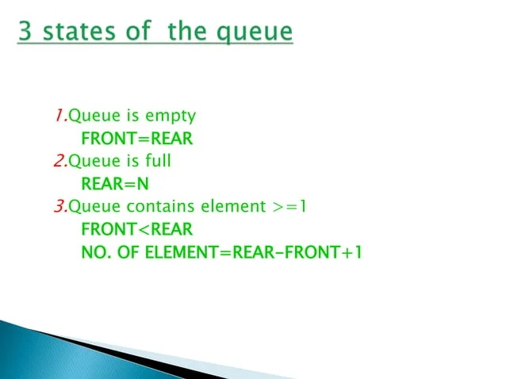

Slide 35
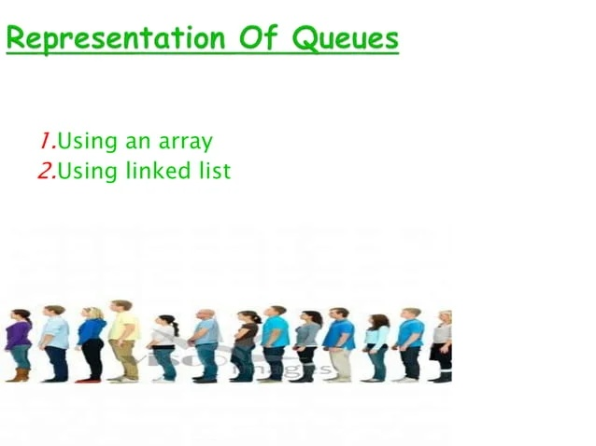

Slide 36


